Slide 1



Indirect Local Attacks for Context-aware
Semantic Segmentation Networks
European Conference of Computer Vision 2020 ID: 3995, Spotlight
Krishna Kanth Nakka and Mathieu Salzmann
Notes:
Hi, I'm Krishna from EPFL. I'm a PhD student at CVLab supervised by Mathieu Salzmann
Press

Slide 2
Indirect Local Attack on Segmentation Networks
Contribution. We expose the vulnerability of context-aware segmentation networks to indirect local attacks, where perturbation in static class region effects the prediction in dynamic class region.
Experiment Setting.
Perturbation inside static class regions
road, sidewalk, building, wall, fence, pole, traffic light, traffic sign, vegetation, terrain, sky
Fooling the dynamic class regions
person, rider, car, truck, bus, train, motorcycle, bicycle
Targeted attack
Dynamic class regions are fooled to output the (spatially) nearest static class label (e.g. car -> road, bus -> road)
potentially creating a collision in autonomous driving scenario.
Notes:
In this paper, we expose the vulnerability of context-aware segmentation networks to indirect local attacks, where the perturbation in one class region effects the predictions in completely different region.
We use the cityscapes dataset for our experiments in which the labels can be divided into two sets, static and dynamic
In particular, we add perturbations in the static region such as road, building and fool the dynamic classes like cars, buses, train.
We perform a targeted attack to misclassify dynamic class objecct to a spatially nearest static label, potentially creating a collision in autonomous driving scenario.

Slide 3
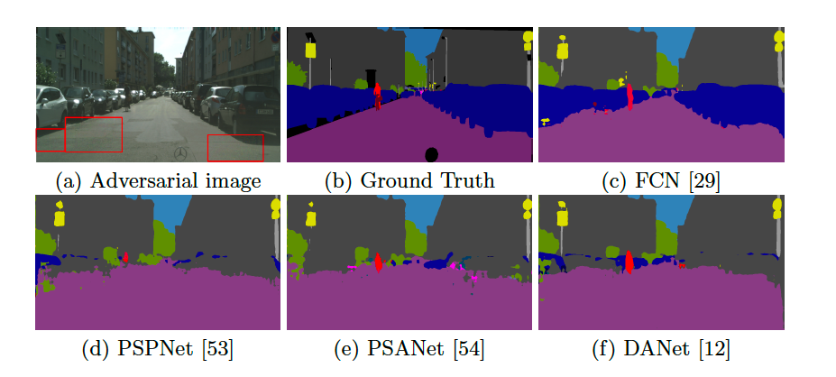
Overview: Indirect Local Attacks
We discover that modern context-aware networks are vulnerable to indirect local attacks. Particularly, the location of perturbation and fooling is different.
Imperceptible perturbations inside few static regions shown as red boxes
FCN is robust to attacks
(No context)
(context by pooling)
(context by point-wise spatial attention)
(context by spatial & channel attention)
Dynamic regions belonging to car, pedestrians far away from perturbed area are effected in modern networks (PSANet, PSPNet, DANet) that use surrounding context
Notes:
We briefly show the the effectiveness of indirect local attacks to modern segmentation networks
For example, we estimate the optimal location of perturbation which is added within few small regions of road as shown in red boxes.
Press
We observe that a FCN, which does not use context, is robust to indirect attacks.
Press
However, the effect of the perturbation is propagated to faraway regions in context-aware networks such as PSP, PSA and DANet essentially fooling all dynamic objects
Press

Slide 4
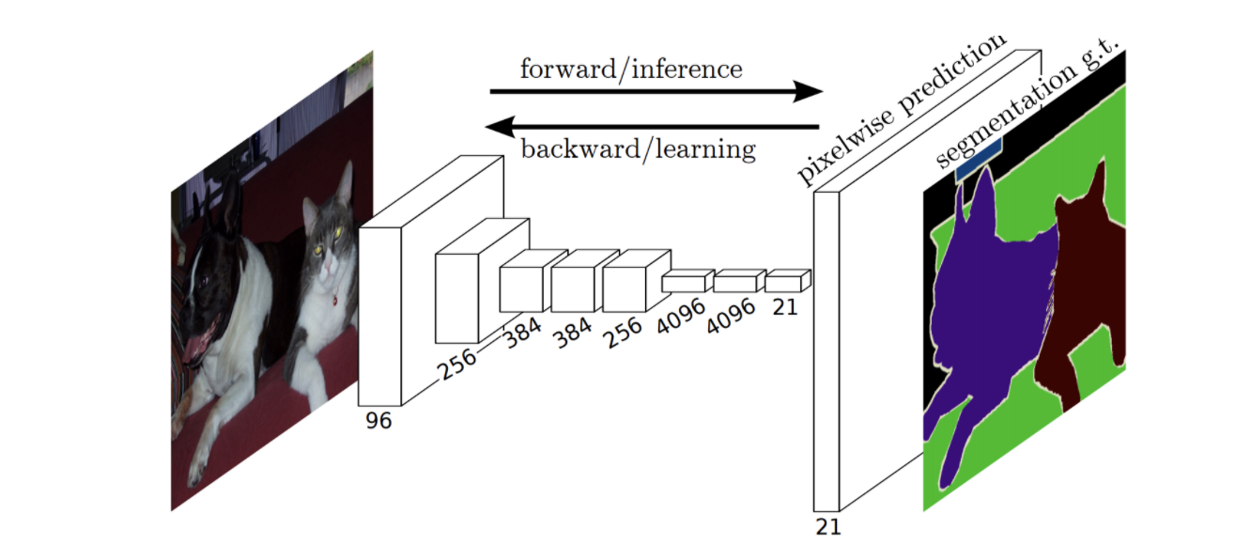
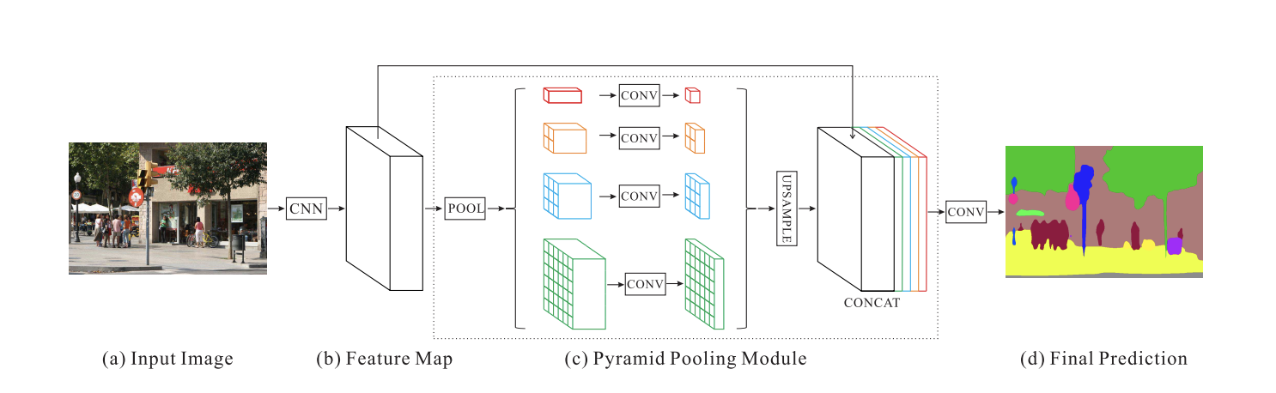
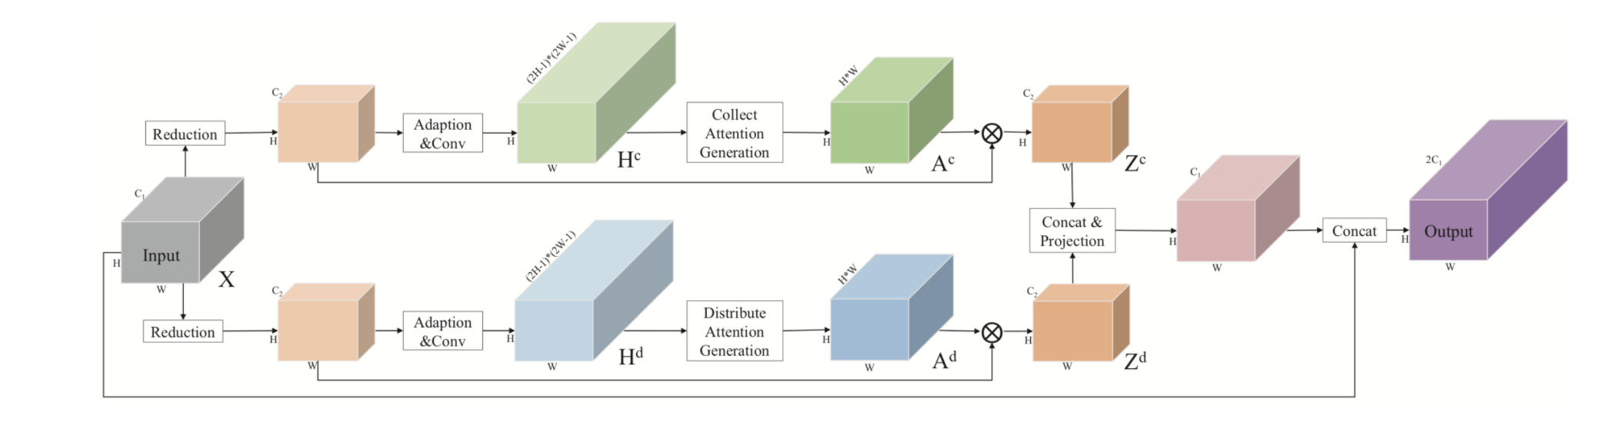
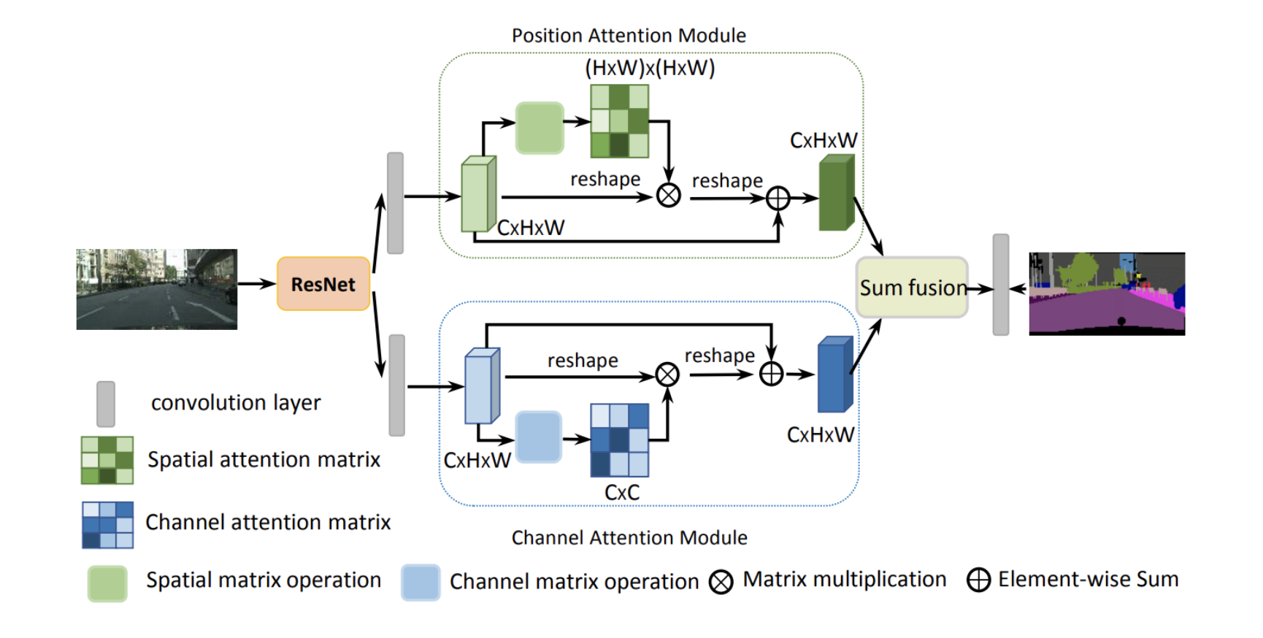
Context in Semantic Segmentation Networks
1. Vanilla FCN
2. PSPNet: Context by spatial pyramid pooling
3. PSANet: Context by pointwise spatial attention
4. DANet: Context by spatial & channel attention
Notes:
we now briefly review the state of the art segmentation entworks
The first end to end deep segmentation network, FCN. is inspired from image classification backbones , which do not use additional context
Later, to improves the performance, many works have proposed to use context in different forms..
PRESS
PSPNet uses context by pooling features at 4 levels, which is further resized and concatenated to original feature.
PRESS
PSANet learns context by connecting each point in feature map to all other locations in an adaptive way
PRESS
such a similar self attention is also used in DANet but it also has additional channel-wise attention along with spatial attention
Athough, all the modern networks use some form of context to build more accurate ones on clean data, here we show such models are infact more vulnerable to indirect local attacks.

Slide 5
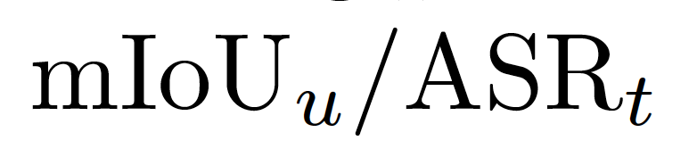
Indirect Attacks
Image-dependent indirect attacks
perturbation location – predetermined
perturbation location – optimized to be within few patches
Image-independent indirect attacks
universal indirect attacks
Metrics:
- mIoU computed b/w adversarial and normal sample predictions
- percentage of pixels that were predicted as the target label
Notes:
We conduct two types of indirect attacks
Image-dependent indirect attack where we either the fix the perturbation location to be fixed or optimized to be within few patches
In the Image-independent case, we learn universal patches on a different training data
We use two metrics:
mIou- - mIoU computed b/w adversarial and normal sample predictions
ASR- - percentage of pixels that were predicted as the target label

Slide 6
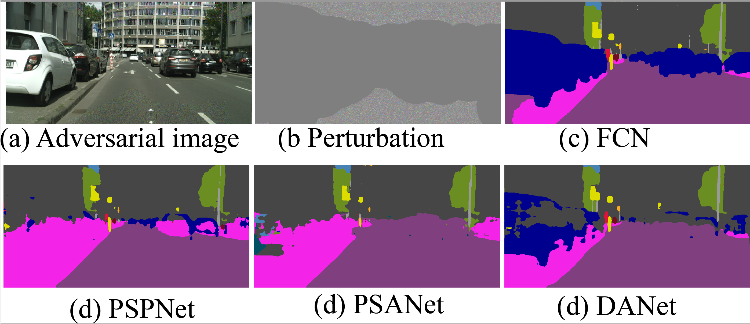
1. Indirect Attack
Perturbation location inside static pixel regions
predetermined
parametric distance d from dynamic class objects
Impact of indirect attacks by perturbing static class pixels that are at least d =100 pixels away from any dynamic class for a 512 x 1024 input image
Notes:
In the first experiment, we predetermine locations to be perturbed inside static regions that are distance d away from dynamic objects.
For a fairly large distance d=100 from the dynamic object boundarry, we observe the context networks such as PSA, PSP are easily fooled while FCN is least effected
PRESS

Slide 7
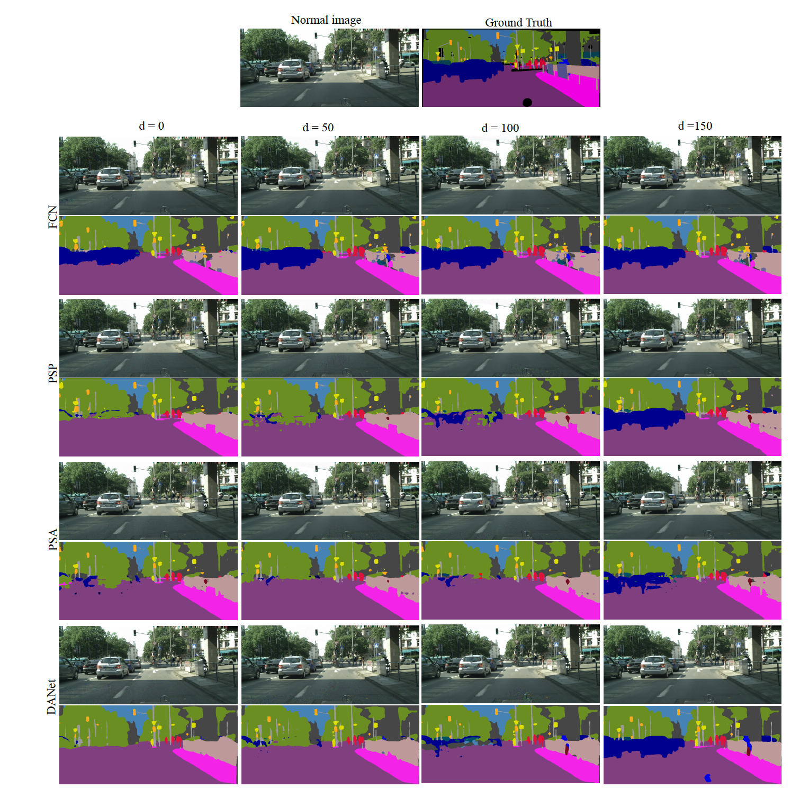
1. Indirect Attack
Perturbation location inside static class regions
Predetermined
not optimized
parametric distance d from dynamic class objects
Impact of indirect attacks by perturbing static class pixels that are at least d pixels away from any dynamic class for a 512 x 1024 input image
Notes:
We show similar results for different networks and by tuning distance d from dynamic object boundary.
As shown in first two rows, an FCN is robust even at d=0, while PSP is more vulnerable than FCN even at fairly large value of d=100 from dynamic object boundary

Slide 8
1. Indirect Attack
Perturbation location inside static class regions
Predetermined
not optimized
parametric distance d from dynamic class objects
Impact of indirect attacks by perturbing static class pixels that are at least d pixels away from any dynamic class for a 512 x 1024 input image
Notes:
Again, for PSA and DANet, they are more vullnerable at d=100 of dynamic object boundary

Slide 9
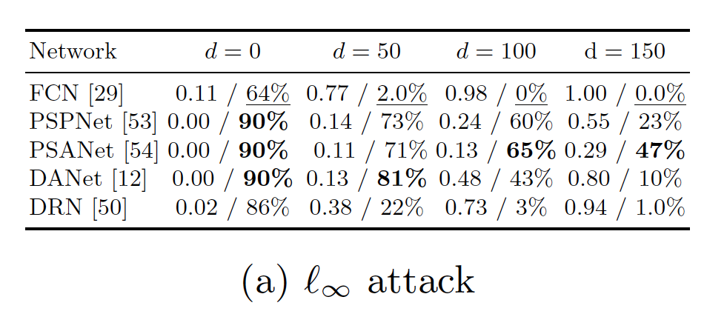
Experiments: Indirect Attack
Impact of local attacks by perturbing pixels that are at least d pixels away from any dynamic class.
Notes:
We quantitively evaluate the effect of indirect attacks by two metrics
The most vulnerable are shown in bold and robust ones are underlined
For a perturbation that are at large distance from dynamic object boundary d=150, PSA has 43% attack success rate as compared to 1% on FCN

Slide 10
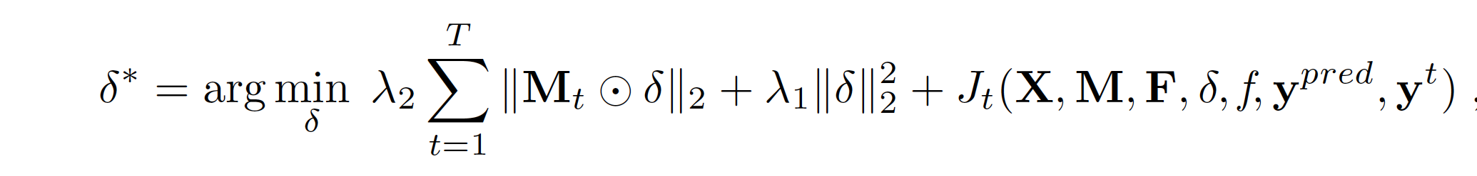
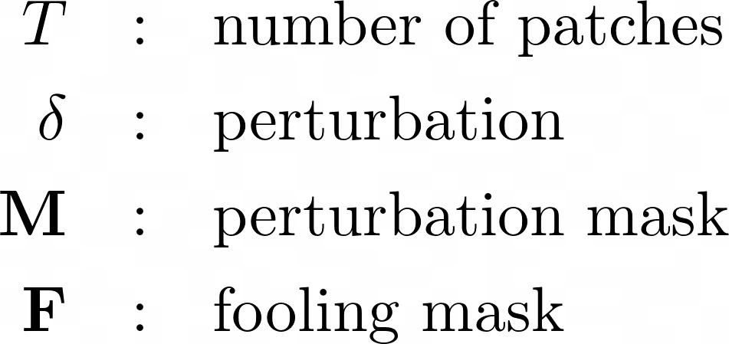
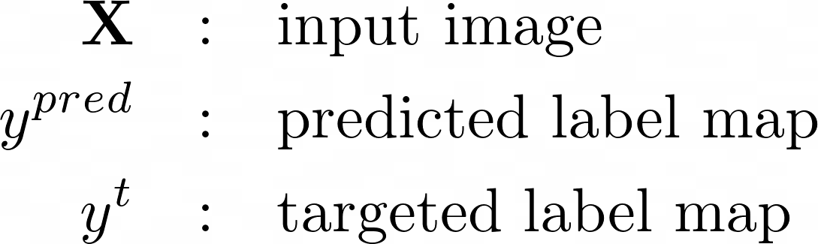
2. Adaptive Indirect Local Attack
Optimally find the best locations to perturb
Notes:
Further we propose an adaptive attack scheme to optimally find best locations to perturb
First, we divide the perturbation denoted by delta into T non overlapping rectangular regions.
We use, M - perturbation mask indicating positions of static regions
F- fooling mask indicates positions of dynamic regions
We optimize the location to perturb by enforcing group sparsity prior L2,1 at patch level
As a result of this, some of these group tends to go to zero, effectively constraining perturbation to be within few locations

Slide 11
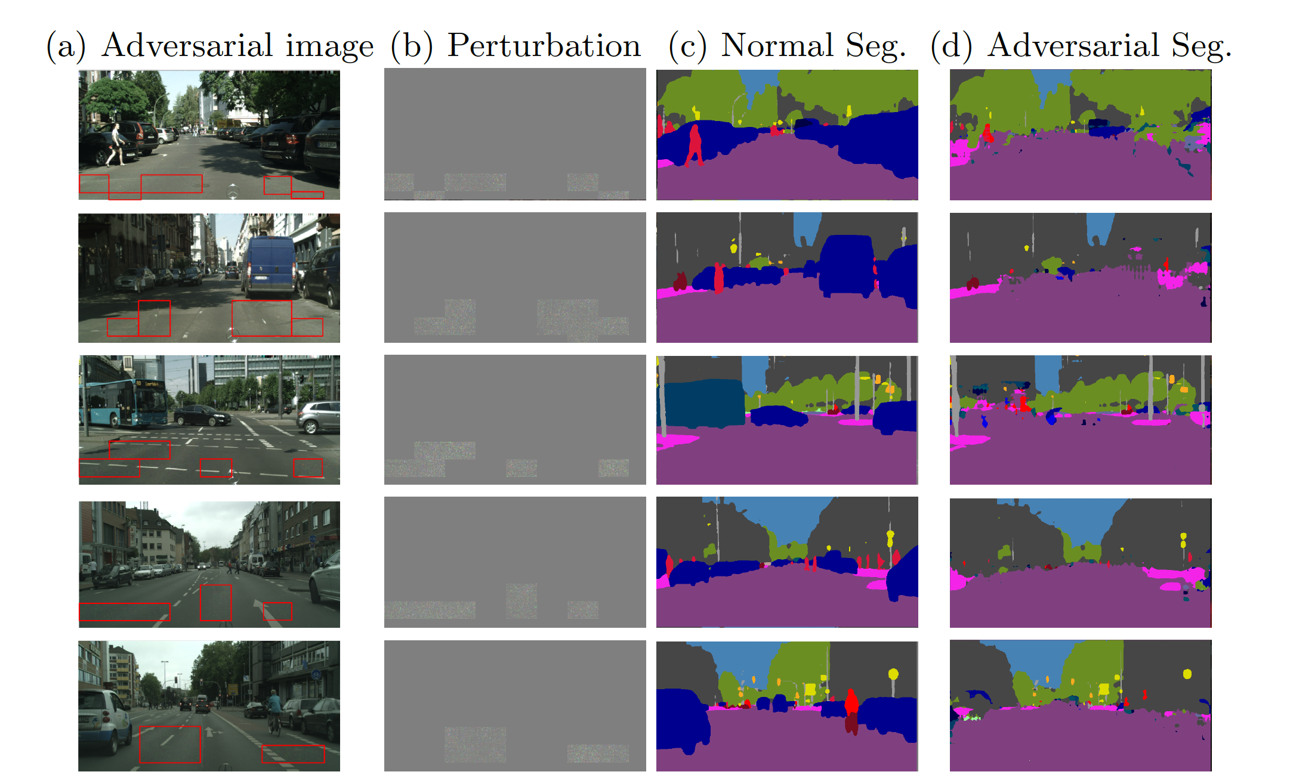
2. Adaptive Indirect Attack on PSANet
Perturbation location
Confined to few patches in static regions
Optimized by group sparsity prior at patch level
Cityscapes
Notes:
We observe most of the dynamic objects in clean segmentation as shown in third column is fooled into a static class label by adding perturbations in few local regions as shown in red boxes
PRESS

Slide 12
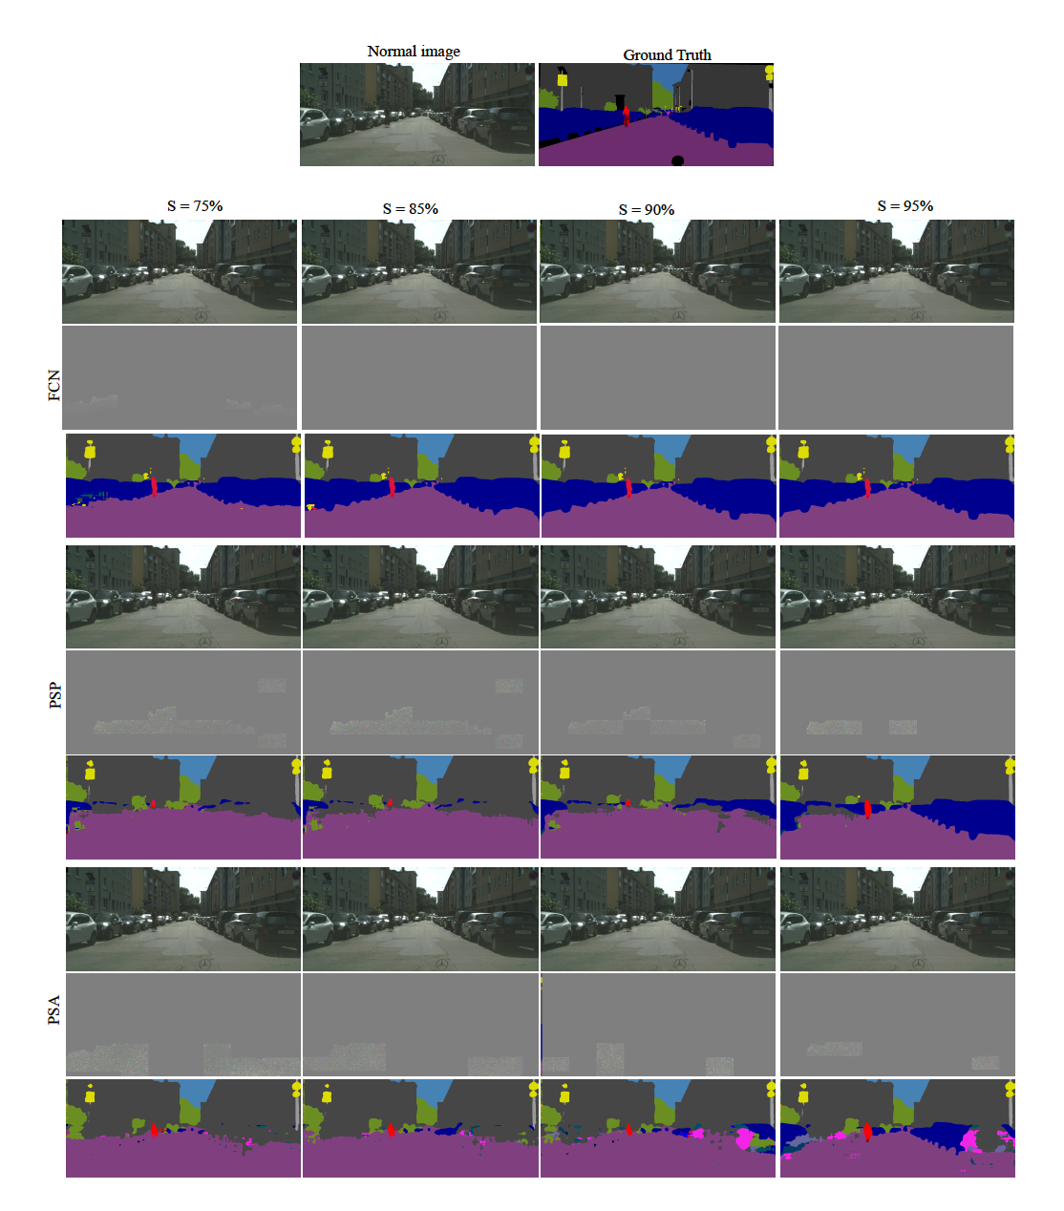
2. Adaptive Indirect Attack
Perturbation location
Confined to few patches in static regions
Optimized by group sparsity prior at patch level
Sparsity
percentage of pixels that are not perturbed relative to the initial perturbation mask
Cityscapes
Notes:
We now show results for different levels of sparsity. High sparsity indicates very few patches are perturbed
For a given sparsity level, we rerun the optimization without group sparsity prior, but we limit the perturbation to be in patches based on strength of delta obtained in first step
At high levels of sparsity S=90%, PSPNet is vulnerable to attacks than FCN.

Slide 13
2. Adaptive Indirect Attack
Perturbation location
Confined to few patches in static regions
Optimized by group sparsity prior at patch level
Sparsity
percentage of pixels that are not perturbed relative to the initial perturbation mask
Cityscapes
Notes:
Similarly for PSA, at high sparsity levels of 90, the attack is failry successful

Slide 14
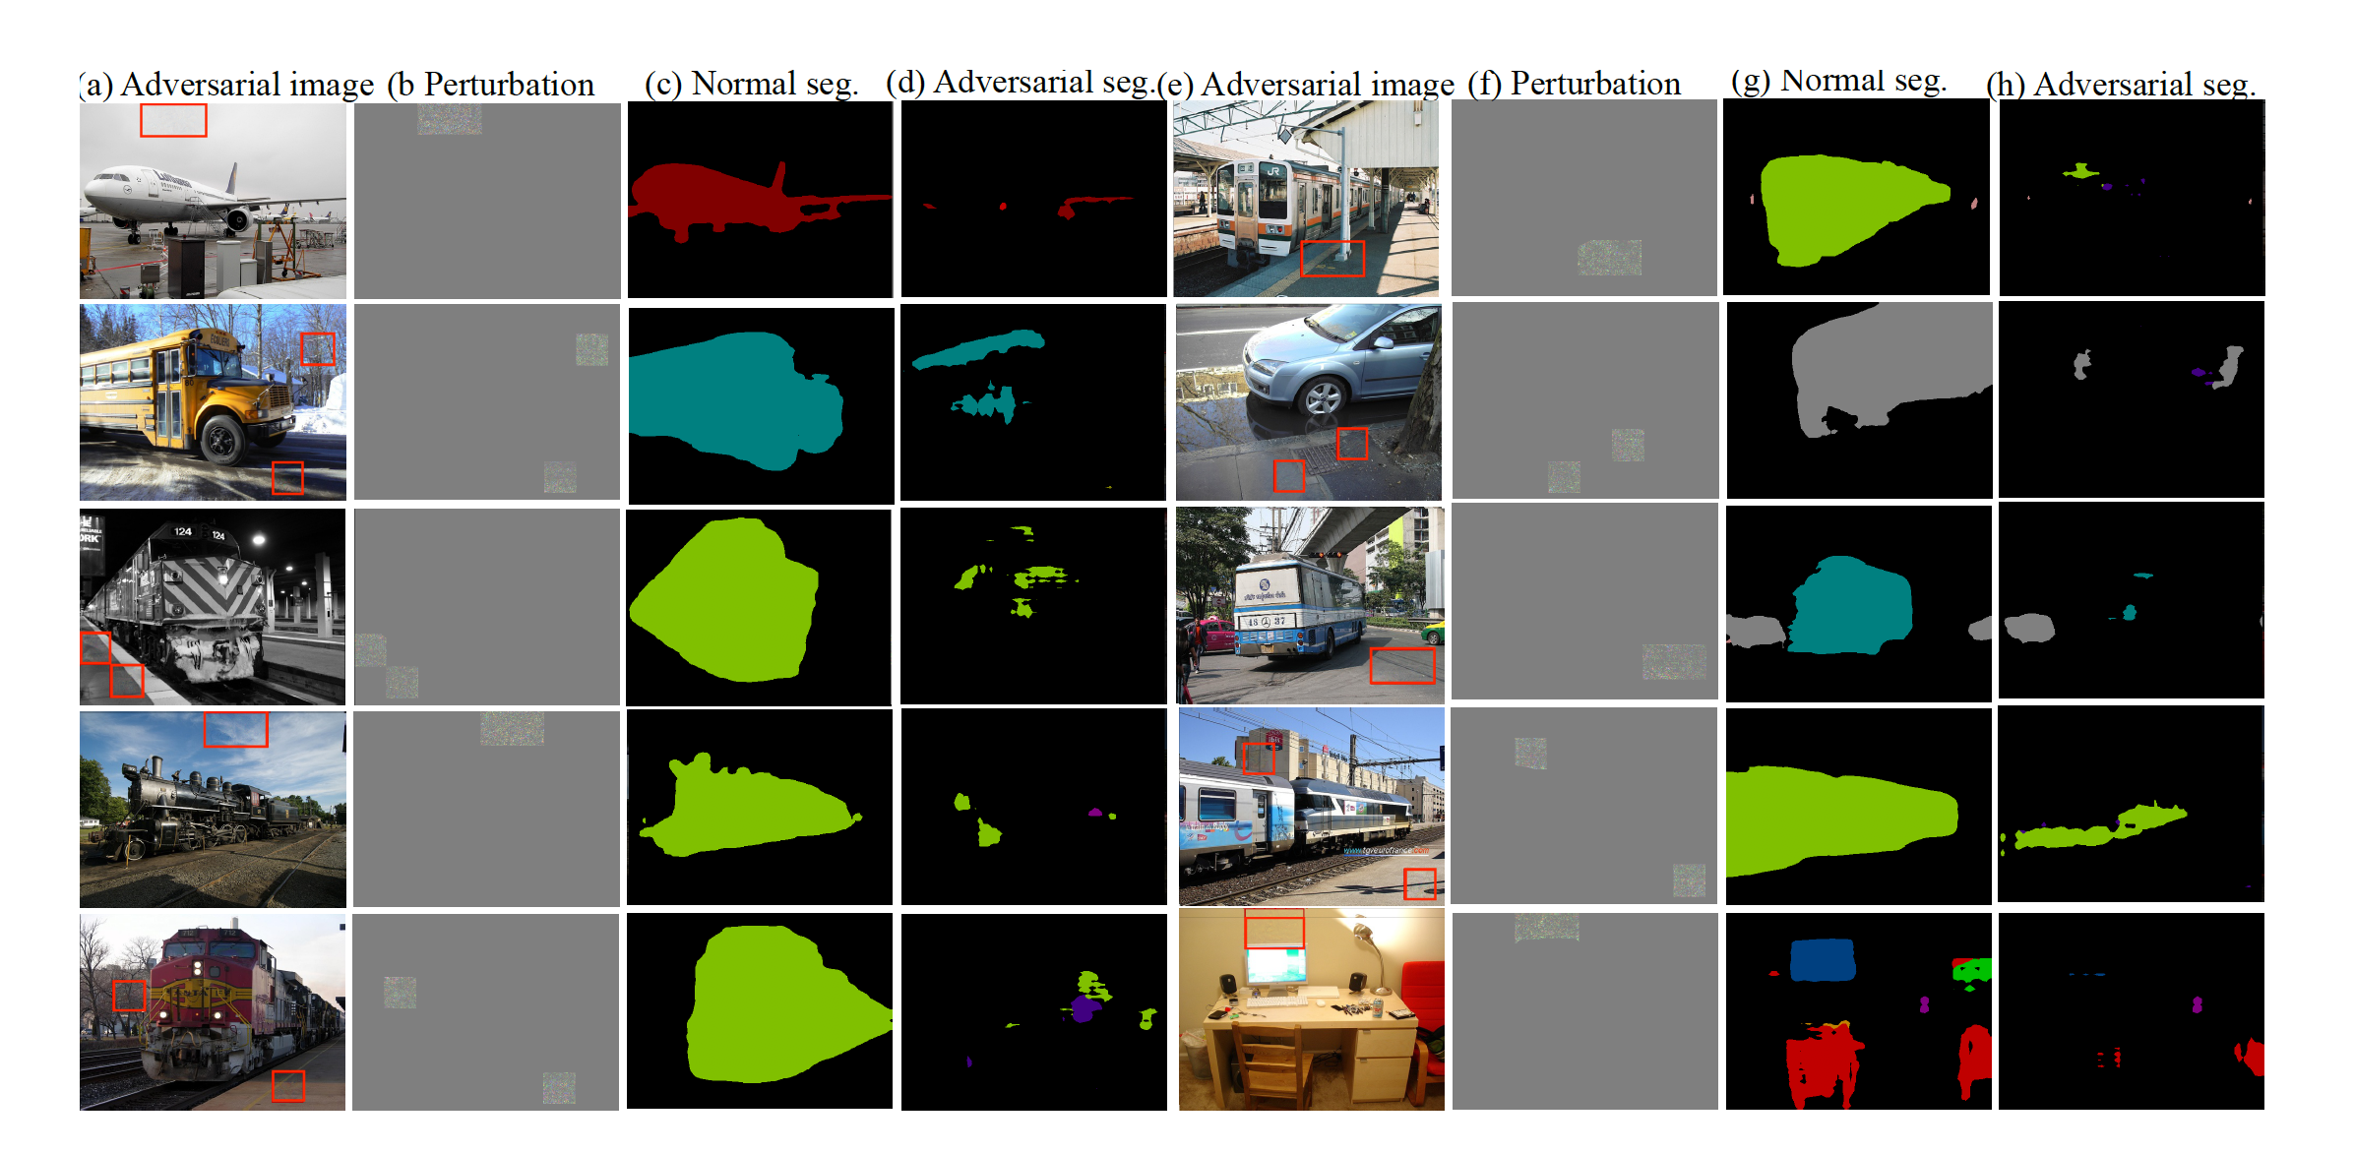
2. Adaptive Indirect Attack on PSANet
Perturbation location
Confined to few patches in static regions
Optimized by group sparsity prior at patch level
PASCAL VOC
Notes:
The same is the case for PASCAL VOC, where a small patch effects the large foreground objects such as bus, train and car. In the following slides, we provide more results of adaptive attack set up case on PASCAL VOC

Slide 15
2. Adaptive Indirect Attack on PSANet
Perturbation location
Confined to few patches in static regions
Optimized by group sparsity prior at patch level
PASCAL VOC
Notes:
The same is the case for PASCAL VOC, where a small patch effects the large foreground objects such as bus, train, car. In

Slide 16
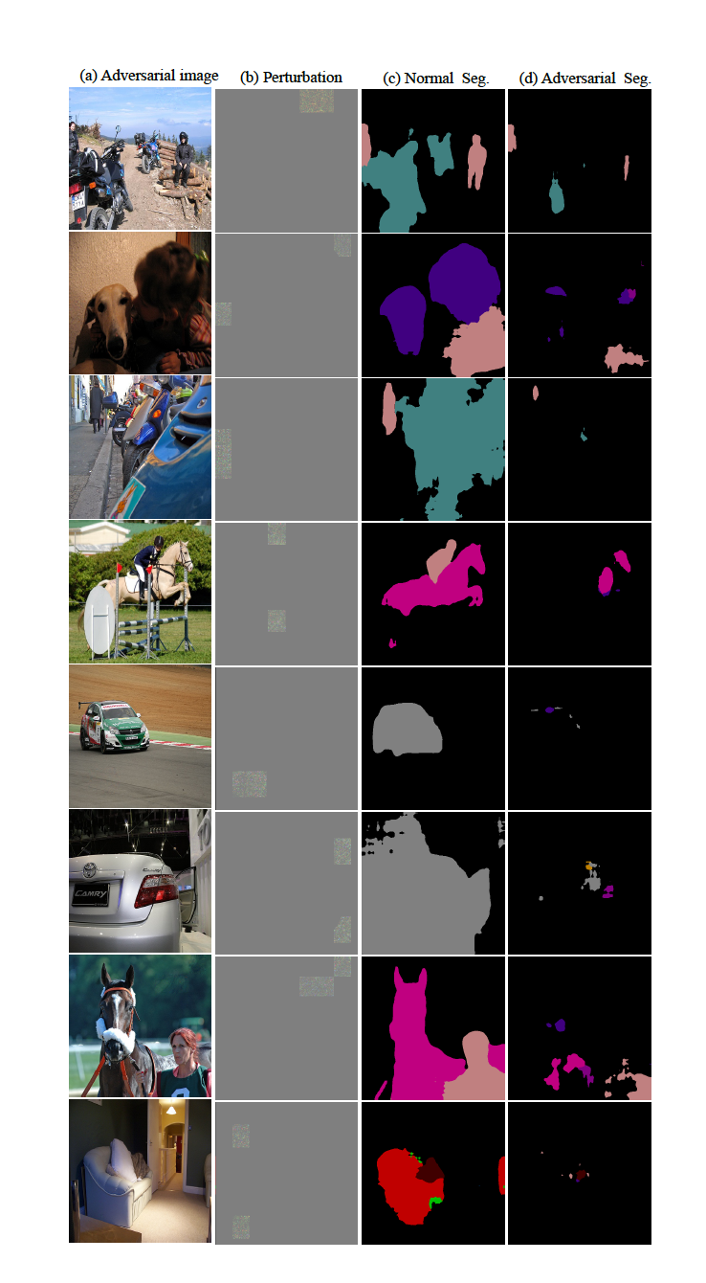
2. Adaptive Indirect Attack on PSANet
Perturbation location
Confined to few patches in static regions
Optimized by group sparsity prior at patch level
PASCAL VOC
Notes:
The same is the case for PASCAL VOC, where a small patch effects the large foreground objects such as bus, train, car.

Slide 17
2. Adaptive Indirect Attack on PSANet
Perturbation location
Confined to few patches in static regions
Optimized by group sparsity prior at patch level
PASCAL VOC
Notes:
The same is the case for PASCAL VOC, where a small patch effects the large foreground objects such as bus, train, car.

Slide 18
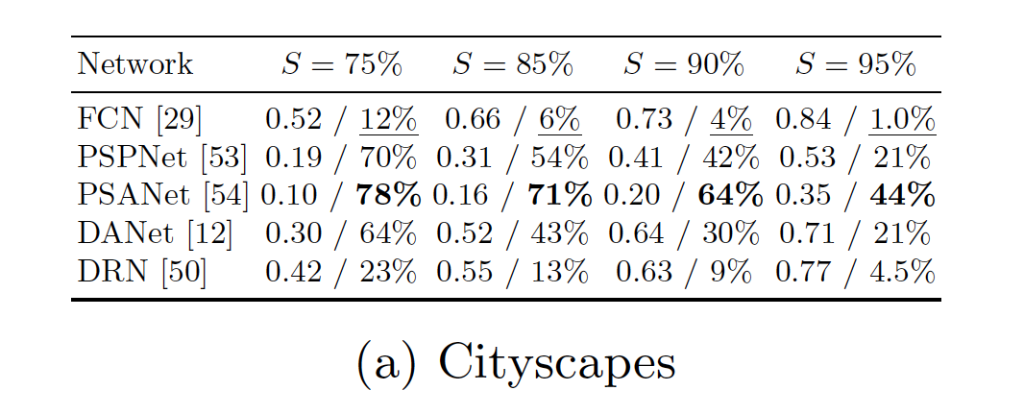
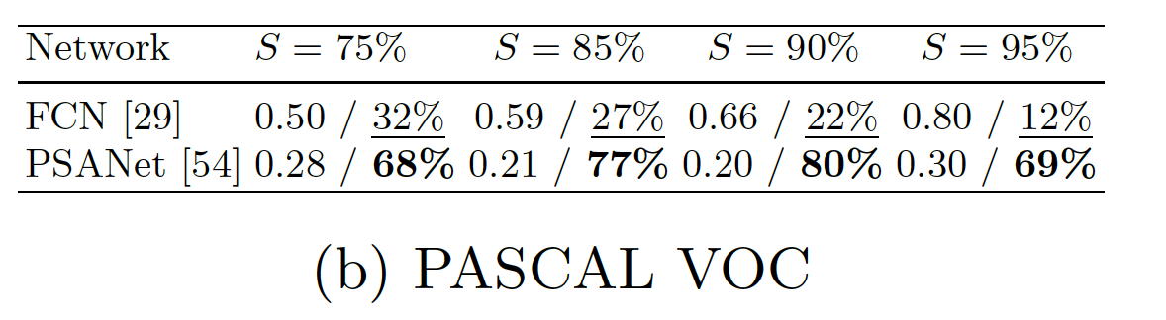
Experiments: Adaptive Indirect Attack
Performance of adaptive indirect local attacks for a given sparsity level
Notes:
Quantitatively, Even at high levels of sparsity, say at 95%, PSANett has 44% attack success arte unlike 1% for FCN

Slide 19
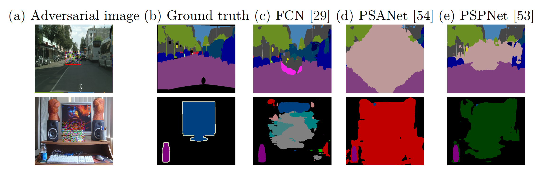
3. Universal Attack
Image-independent
Perturbation location
confined to a single patch at the center
Untargeted attack to fool entire image
Universal local attacks on Cityscapes and PASCAL VOC using a single fixed size patch
Notes:
In the third set of experiment image independent case,
we learn a universal fixed size adversarial patch basing on training data that is placed at the center of the image. Unlike the targeted attacks in first two mentioned before, this experiment is untargeted to attack entire image not just dynamic class

Slide 20
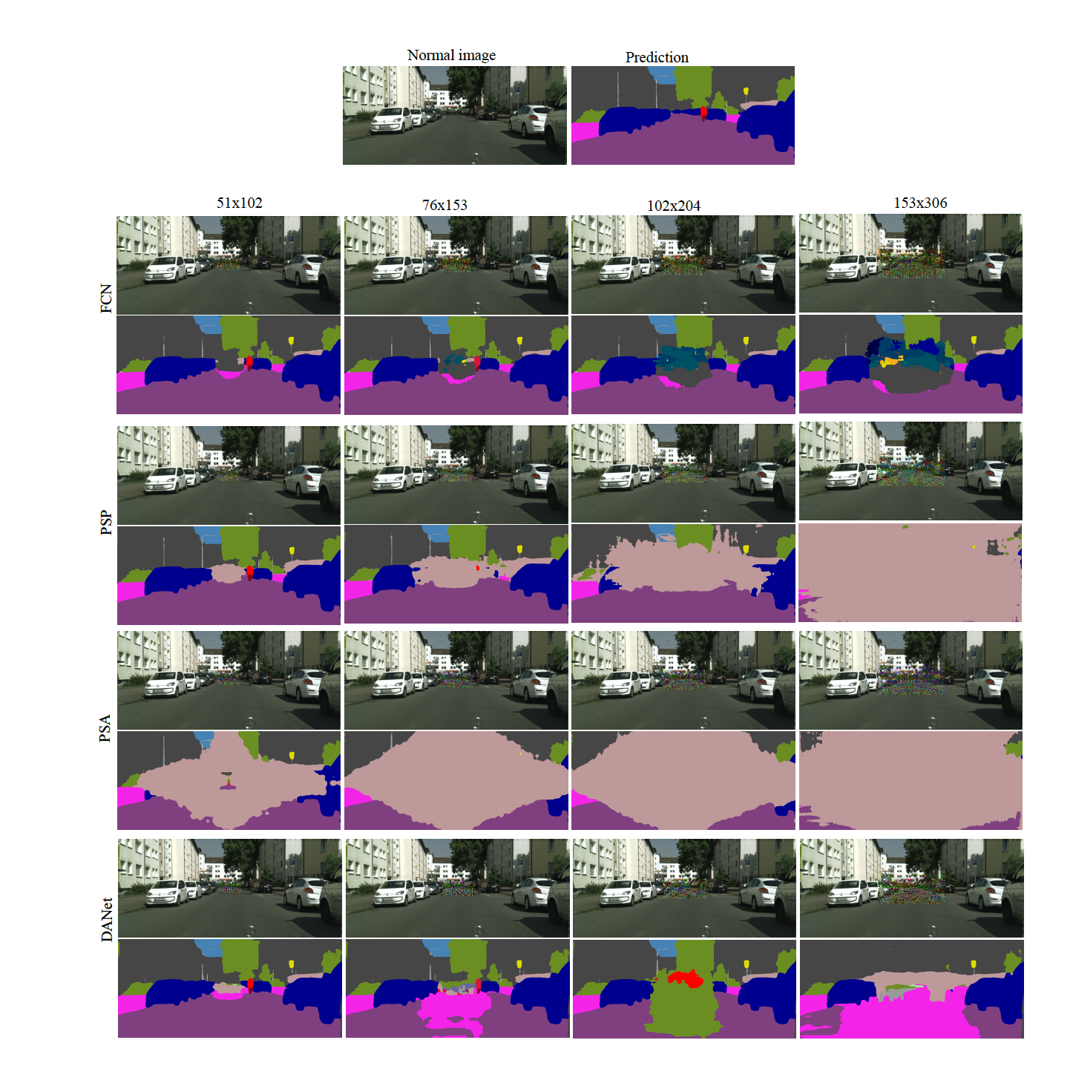
3. Universal Attack
Image-independent
Perturbation location
confined to a single patch at the center
Untargeted attack to fool entire image
Universal local attacks on Cityscapes using a different sizes of patch
Notes:
here we show results by changing the size of adversarial patch.
A patch with area 9% can effecttively disturb predictions of complete image for PSP net whille mostly llimiting itss effect within pertubation region for FCN

Slide 21
3. Universal Attack
Image-independent
Perturbation location
confined to a single patch at the center
Untargeted attack to fool entire image
Universal local attacks on Cityscapes using a different sizes of patch
Notes:
the same results is also observed for PSANet and DAnet

Slide 22
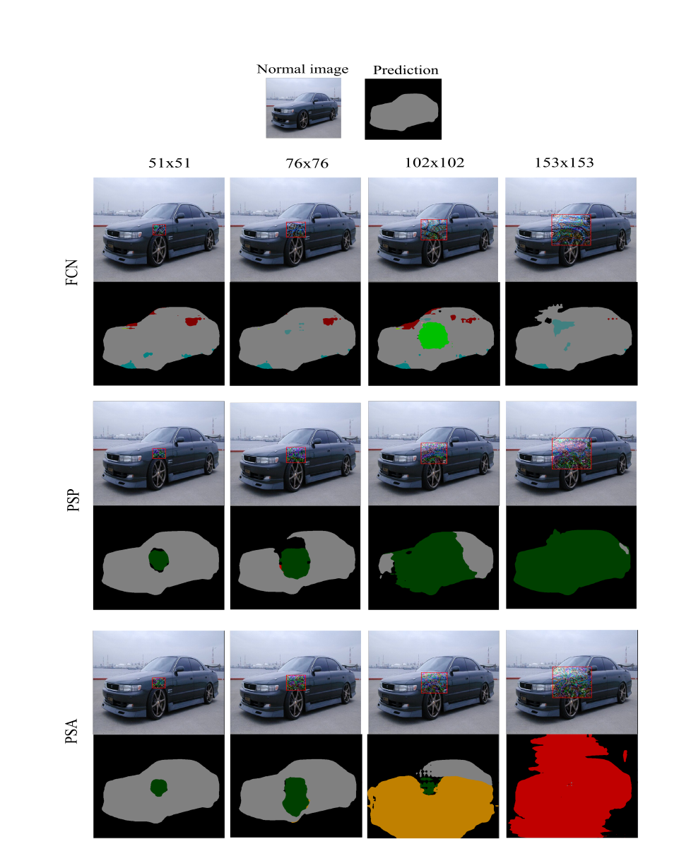
3. Universal Attack
Image-independent
Perturbation location
confined to a single patch at the center
Untargeted attack to fool entire image
Universal local attacks on PASCAL VOC using a single fixed size patch
Notes:
More results of universal attacks on PASCAL VOC is shown here.
the labels of car are changed to different label while the effect is very local for FCN

Slide 23
3. Universal Attack
Image-independent
Perturbation location
confined to a single patch at the center
Untargeted attack to fool entire image
Universal local attacks on PASCAL VOC using a
single fixed size patch
Notes:
also for PSANet, the effect is propgated to far away regions.

Slide 24
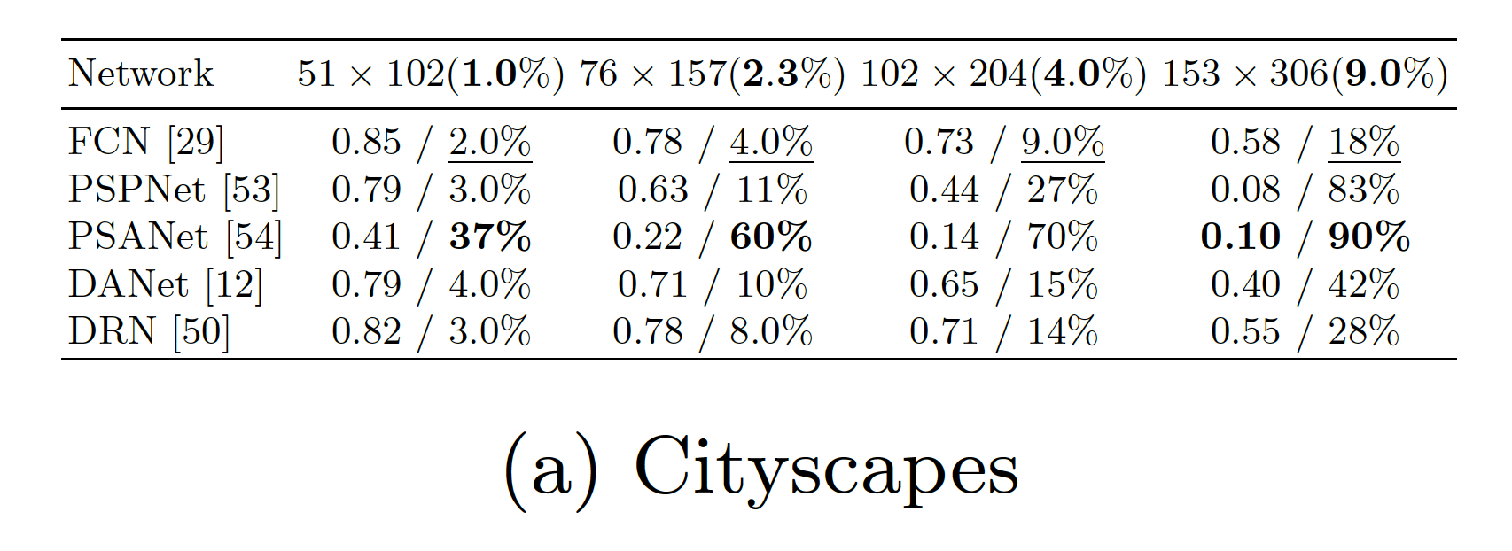
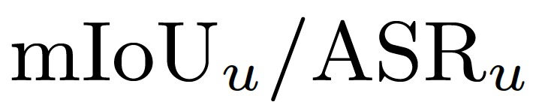
Experiments: Universal Attack
Impact of universal local attacks by perturbing patch of size h x w (area%) for 512 x 1024 input image
Notes:
Following the same trend in previous experiments, a small patch 9% by area at the center can effectively attack 90% of image for PSANet and 83% for PSPNet.

Slide 25
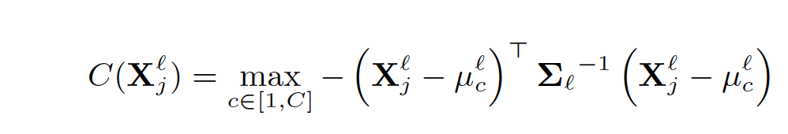
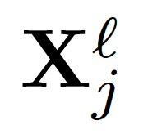
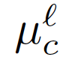
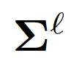
Experiments: Attack Detection
We detect the region of fooling by computing Mahalanobis distance between feature and nearest class-conditional distribution at every spatial location j
feature at location j and layer l
Class-specific mean at layer l
covariance at layer l
Notes:
Next, To defend to adversarial attacks, we extend detection approaches proposed in image classification domain.
Particularly, we extract the confidence value as the distance b/w feature and nearest class conditional distribution
Specifically, we learn the class specific means and share covariance at every layer and then learn a logistic detector using confidence as feature values

Slide 26
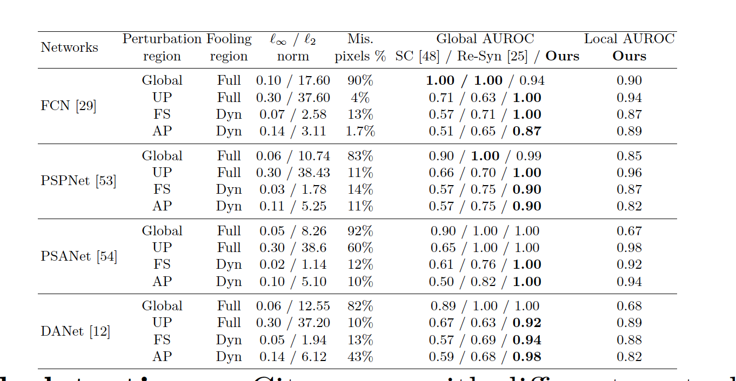
Experiments: Attack Detection
Attack detection on Cityscapes with different perturbation settings
Global – full image perturbations FS – full static region perturbations
UP - universal patch perturbations. AP – adaptive attack perturbations
Notes:
We are better than state of the art, SC (scale consistency and Re-syn) for detecting at image level. Both these approaches are designed to detect attack at global image level and only works when complete image is fooled
Our detection also helps to detect the fooled regions at pixel level.
SC – checks the consistency of predictions between fairly overlapping patches
Resynt – compares the original image and resynthesized image from label map in hog feature space. Which is not ideal when attack is very local.

Slide 27
Summary
We show the vulnerability of modern context-aware networks to various indirect attacks
We propose adaptive indirect attack based on group sparsity
We evaluate the impact of context to universal fixed-size patch attacks
We propose pixel-level detection of fooling regions based on Mahalanobis distance
Notes:
to conclude,
we expose vulnerability of context dependent networks to various indirect attacks. We show a perturbation in few regions in the static scene can have serious effects on dynamic objects in the scene due to context dependencies. we also propose a detection scheme to identify the fooled regions both at image and pixel level.
Thank you

